Slide 1
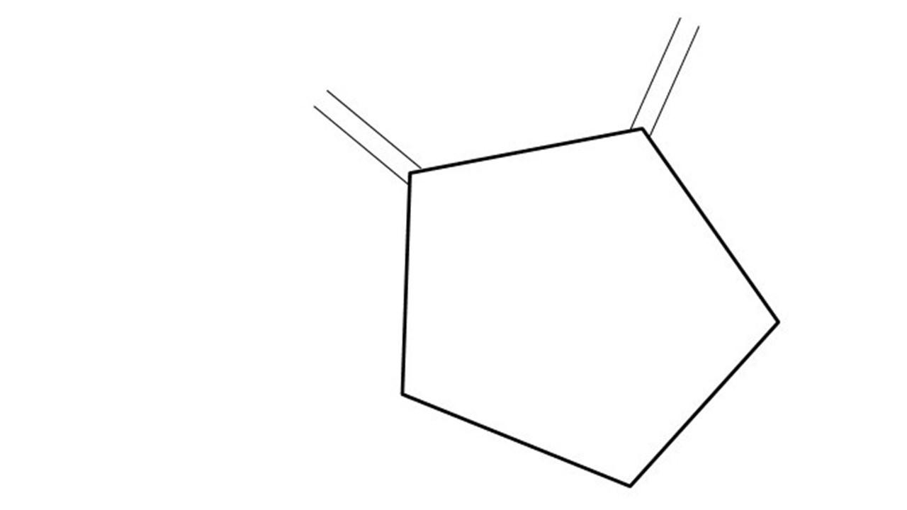


Great Cow BASIC Part 8
Great Cow BASIC for the PIC16F171xx chip Family
Oct 2022

Slide 2
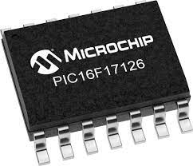
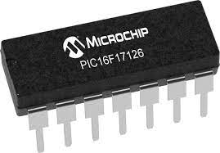
PIC16F171xx
PIC16F171xx is a high performance PIC16
Digital and Analog peripherals
12-bit ADC
Multiple communication interfaces
Serial, I2C, SPI
PWM – CCP/PWM and 16Bit
Configurable Logic Cells
OpAmp
The PIC16F171xx offers 8 to 20 pin products in small footprint packages to support customers in a variety of space constrained and sensor node applications.

Slide 3
Videos...
Install the hardware and make the board work – three LED programs
Make four LEDs flash in a sequence
Set the LEDs to represent the value of ADC
Sequence the LEDs with a delay using the value of ADC
Using an input to set the state of the LED
Using the reset switch
Using the switch, ADC – make the LEDs flash in a sequence with reverse
Using the serial to display values
Using the timer0 overflow, 8bit timer, 16bit timer to flash the LEDs
Using CCP/PWM to dim the LEDS
Using I2C with serial to discover I2C devices
Using EEProm – showing values on the serial terminal
Using an I2C GCLD display
Using an SPI GCLD display
Using PWM to dim the LEDS
Using memory within the PIC – Progmem and SAF memory
The Great Cow BASIC tool chain
Assembly and alternatives assemblers
Summary

Slide 4
Great Cow BASIC Compiler
Great Cow BASIC is an Open Source compiler for Microchip PIC &AVR and Logic Green AVR microcontrollers
Great Cow BASIC now supports the 16F171xx chip family
Great Cow BASIC Compiler

Slide 5
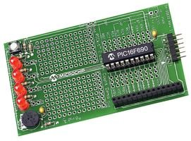
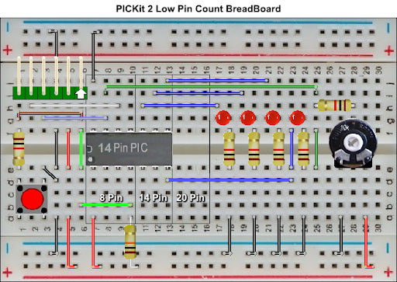

Hardware
Microchip Low Pin Count Demo Board
PICKit_2_Low_Pin_Count_User_Guide_51556a.pdf
By Chris Roper

Slide 6
Serial output
Output
Using the built-in Universal Synchronous/Asynchronous Receiver Transmitter (USART) on the PIC® Microcontroller to communicate with serial terminal on a PC
Baseline is the tutorial we have been using plus a TTL/USB serial converter

Slide 7
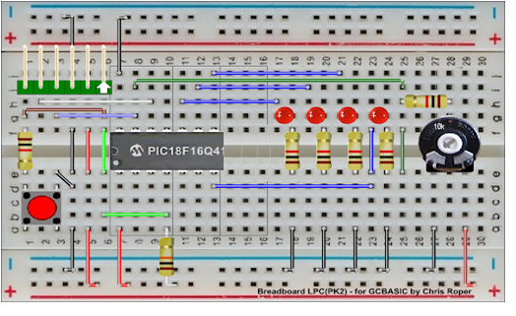
Hardware
GND
Layout
16F17126
By Chris Roper
TX on PORTC.4

Slide 8
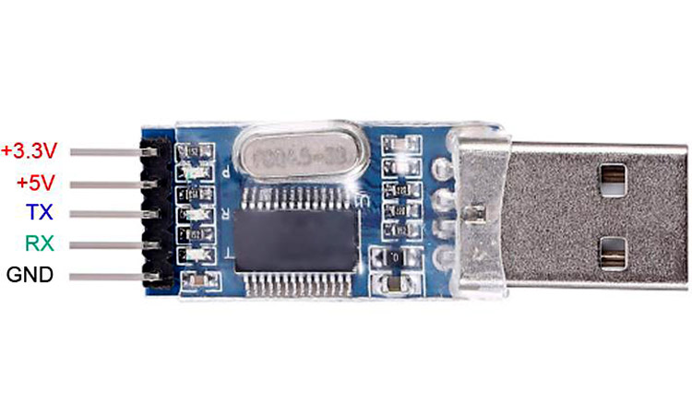
Serial output
GND and RX (RXD)
TX on PORTC.4
0V

Slide 9
Peripheral Pin Select (PPS)
PPS configuration provides the method to these choices set the functionality and their placement on a wide range of I/O pins.
By increasing the pinout options available on a particular device, users can tailor the device to their entire application.
For Serial we must set the TX the PPS

Slide 10
Peripheral Pin Select (PPS)
Access via PICInfo
Access directly

Slide 11
Tutorial overview
Initialise
Serial up the serial
Initialise
Do forever
Read ADC
Determine if switch state changed
Set state of LEDs
Wait
Loop
Do Forever
ReadADC
Send Values to Serial
Switch state changed
Right
Left
Set State of LEDs
Set State of LEDS
Wait

Slide 12
Lab
Examine the sample code
Review the results

Slide 14
Videos...
Install the hardware and make the board work – three LED programs
Make four LEDs flash in a sequence
Set the LEDs to represent the value of ADC
Sequence the LEDs with a delay using the value of ADC
Using an input to set the state of the LEDs
Using the reset switch
Using the switch, ADC – the LEDs flash in a sequence with reverse
Using the serial to display values
Using the timer0 overflow, 8bit timer, 16bit timer to flash the LEDs
Using CCP/PWM to dim the LEDS
Using I2C with serial to discover I2C devices
Using EEProm – showing values on the serial terminal
Using an I2C GCLD display
Using an SPI GCLD display
Using PWM to dim the LEDS
Using memory within the PIC – Progmem and SAF memory
The Great Cow BASIC tool chain
Assembly and alternatives assemblers
Summary

Slide 15
Great Cow BASIC Part 8
Great Cow BASIC for the PIC16F171xx chip Family
Oct 2022

Slide 17
Backup Slides

Slide 18
Initialise
Set 1st LED
Wait for a Delay
Rotate the LEDs
Did it overflow ?
No
Yes
Set 1st LED

Slide 19
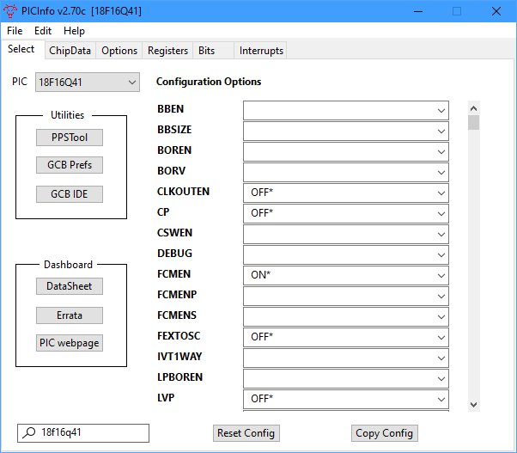
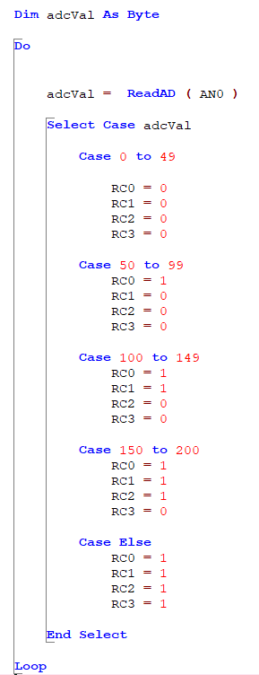
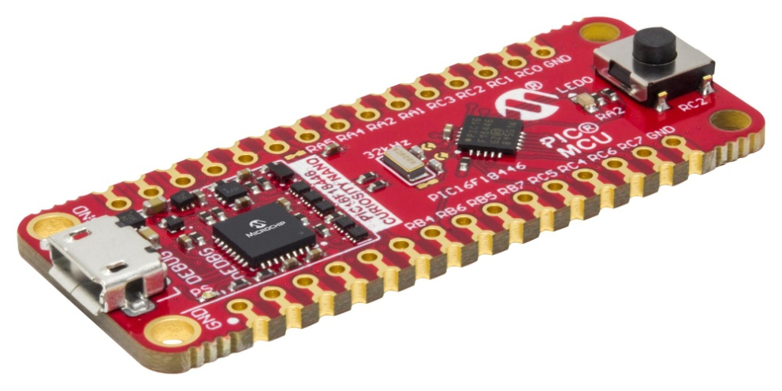
Analog-to-Digital

